Slide 1
Outline
Introduction
Workflow
Implementation Details
Analysis and Results
Conclusion
Notes:
The project focuses on addressing critical challenges faced in modern high-frequency antenna systems, including:
- Phase Noise: A significant issue in local oscillators that can lead to signal distortion.
Power Consumption: A challenge in ultra-high-speed receivers, especially with ADC-based designs.
SFDR Degradation: Issues with spurious signals affecting the dynamic range of the system.
Insertion Loss: Signal strength reduction in transmission lines.
This project leverages MATLAB and Simulink to analyze these issues and propose simulation-based solutions.

Slide 2
INTRODUCTION
This project focuses on addressing challenges in high-frequency antenna systems, including:
Phase noise
Power consumption
SFDR degradation
Insertion loss
Code:
Modular MATLAB
scripts: Parameters.m, implementation.m, analysis.m
Phase noise reduction using PLL simulation
Improved workflow for simulation and analysis
Notes:
1. Introduction: Overview of the challenges in high-frequency antenna systems and the motivation for this project.
2. Updated Workflow: Description of the modular workflow implemented using MATLAB scripts.
3. Implementation Details: Explanation of each MATLAB script and its role in the simulation.
4. Analysis and Results: Summary of phase noise, jitter, and system performance metrics.
5. Conclusion: Key findings and future scope of the project.

Slide 3
Motivation And Project Focus
High-frequency antenna systems face several challenges:
Phase Noise: Degrades signal quality and causes communication errors.
Power Consumption: A major constraint for high-speed ADC-based systems.
SFDR Degradation: Affects dynamic range, introducing spurious signals.
Insertion Loss: Reduces transmission efficiency.
To address these challenges, this project:
Develops modular MATLAB scripts for parameter configuration, system implementation, and result analysis.
Uses phase-locked loop (PLL) simulation to reduce phase noise.
Improves the overall workflow for simulation and analysis, making it efficient and adaptable.
Notes:
Introduces the motivation and context for the project.
High-frequency antenna systems face various challenges, including:
- Phase Noise: Degrades signal quality, leading to errors in communication systems.
- Power Consumption: A critical limitation for high-speed ADC-based systems.
- SFDR Degradation: Affects the dynamic range, causing spurious signal issues.
Insertion Loss: Reduces the efficiency of signal transmission.
To address these challenges, the project focuses on:
- Developing modular MATLAB scripts for parameter configuration, implementation, and analysis.
Using phase-locked loop (PLL) simulation to reduce phase noise.
Improving the overall workflow for simulation and analysis.

Slide 4
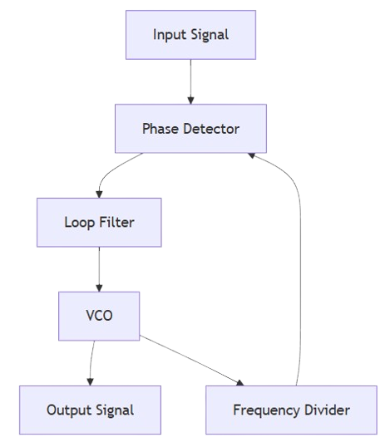
Detailed PLL System with Phase Noise Simulation
- Input Signal: Source for PLL phase noise reduction.
- Phase Detector: Compares phase difference.
- Loop Filter: Stabilizes PLL output.
- VCO: Generates stable frequency.
- Output Signal: Stabilized VCO output.
- Frequency Divider: Matches reference signal.
- Phase Noise Model: Simulates VCO phase noise.
Notes:
Input Signal: The source signal to be processed by the PLL system for phase noise reduction.
Phase Detector: Compares the phase difference between the input and feedback signals.
Loop Filter: Filters the output from the phase detector to stabilize the PLL system.
VCO (Voltage-Controlled Oscillator): Produces a stable frequency signal controlled by the loop filter output.
Output Signal: The stabilized output signal produced by the VCO.
Frequency Divider: Divides the frequency of the VCO signal to match the reference signal for comparison.
Phase Noise Model: Simulates the phase noise introduced by the VCO and analyzes its effect on the system.

Slide 5
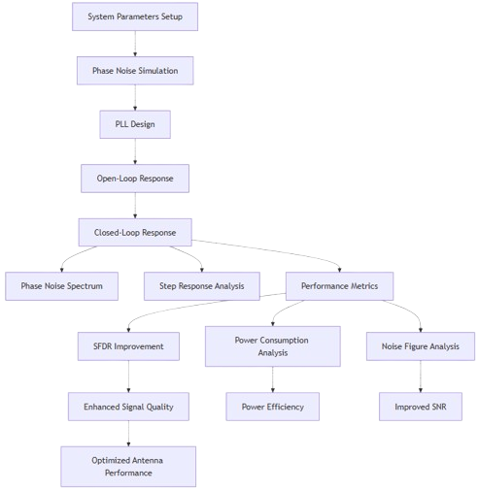
Full Block Diagram of the Project
- System Setup: Init VCO, filter, noise.
- Phase Noise Sim: Simulates effects.
- PLL Design: Optimizes PLL.
- Open-Loop: Frequency response.
- Closed-Loop: Feedback behavior.
- Phase Noise: Visualizes reduction.
- Step Response: Examines stability.
- Performance: Noise, power, SFDR.
- SFDR: Increases range.
- Power Analysis: Optimizes energy.
- Noise Figure: Minimizes noise.
- Signal Quality: Reduces distortion.
- Power Efficiency: Ensures efficiency.
- SNR: Improves ratio.
- Antenna Performance: Final performance.
Notes:
System Parameters Setup: Initialize VCO sensitivity, loop filter coefficients, and phase noise parameters.
Phase Noise Simulation: Simulates phase noise and analyzes its effects on the system.
PLL Design: Designs and optimizes the Phase-Locked Loop system for performance.
Open-Loop Response: Shows the frequency response and gain of the open-loop system.
Closed-Loop Response: Displays the behavior of the system after applying feedback.
Phase Noise Spectrum: Visualizes the reduction in phase noise after PLL implementation.
Step Response Analysis: Examines system settling time, overshoot, and stability.
Performance Metrics: Analyzes phase noise reduction, power consumption, and SFDR improvements.
SFDR Improvement: Increases the spurious-free dynamic range for better signal quality.
Power Consumption Analysis: Optimizes power consumption for energy efficiency.
Noise Figure Analysis: Evaluates the noise figure to ensure minimal noise interference.
Enhanced Signal Quality: Improves overall signal quality by reducing noise and distortion.
Power Efficiency: Ensures the system operates efficiently while maintaining performance.
Improved SNR: Enhances the signal-to-noise ratio for better performance.
Optimized Antenna Performance: Shows the final optimized antenna system performance.

Slide 6
WORKFLOW
Workflow Overview:
Parameters.m:
Defines key system parameters and transfer functions.
Easily configurable for various scenarios.
Implementation.m:
Implements and simulates the antenna system.
Saves simulation data to Implementation_Results.mat.
Analysis.m:
Analyzes the results from implementation.m.
Computes phase noise, jitter, and other performance metrics.
Notes:
Explains the modular workflow implemented in the project, consisting of three key scripts:
1. Parameters.m:
Defines the key parameters of the antenna system, such as PLL loop bandwidth, phase noise, and transfer functions.
Allows for easy customization and configuration.
2. Implementation.m:
Implements the system design and simulates the antenna's behavior.
- Generates and saves simulation data to a .mat file for further analysis.
3. Analysis.m:
Processes the simulation data from Implementation.m.
Computes phase noise contributions, RMS jitter, and visualizes the system's performance metrics.
This workflow ensures modularity, flexibility, and streamlined analysis.

Slide 7
IMPLENTATION DETAILS
Parameters.m:
Defines PLL loop bandwidth, phase margin, and phase noise settings.
Includes transfer functions for PFD, VCO, loop filter, and divider.
Implementation.m:
Simulates the step response and frequency response.
Generates and saves simulation data for analysis.
Analysis.m:
Computes phase noise contributions and RMS jitter.
Generates plots for phase noise spectrum, step response, and frequency response.
Notes:
This slide provides a detailed breakdown of each MATLAB script used in the project:
1. **Parameters.m**:
This script acts as the foundation of the simulation by defining all the critical parameters and transfer functions required for the antenna system. It allows for easy customization and ensures that changes to the system's behavior can be made seamlessly by modifying a single file. Key features include:
- **Loop Bandwidth and Phase Margin Configuration**: Configures the PLL loop bandwidth (e.g., `LoopBW`) and phase margin (e.g., `PM`), which are essential for ensuring system stability and noise reduction.
- **Noise Profiles**: Defines the phase noise profiles for the VCO, reference oscillator, and other components. These profiles help simulate realistic noise conditions.
- **Transfer Functions**:
- **PFD (Phase Frequency Detector)**: Models the relationship between the input phase difference and the output current/voltage.
- **VCO (Voltage-Controlled Oscillator)**: Defines the oscillator's output frequency as a function of the input control voltage, including its phase noise characteristics.
- **Loop Filter**: Implements a 3rd-order passive filter design, which determines the dynamic response of the PLL and its ability to suppress noise.
- **Divider**: Models the frequency division in the feedback loop to match the reference frequency.
By centralizing these configurations, `Parameters.m` ensures modularity and reusability, making it easier to adapt the system for different scenarios or performance requirements.
2. **Implementation.m**:
This script implements the antenna system's simulation using the parameters defined in `Parameters.m`. It focuses on simulating key system behaviors to generate results that are stored for further analysis. Key features include:
- **Step Response Simulation**:
- Simulates the closed-loop response of the system to a step input, allowing the evaluation of system stability and settling time.
- **Frequency Response Simulation**:
- Simulates the open-loop gain and phase characteristics of the system across a wide frequency range, providing insights into the system's bandwidth and phase margin.
- **Result Storage**:
- Saves the simulation outputs (e.g., time-domain and frequency-domain responses) to a `.mat` file (`Implementation_Results.mat`). This ensures that the analysis script can access the data without rerunning the simulations.
This script bridges the gap between parameter configuration and analysis, serving as the execution engine for the system simulation.
3. **Analysis.m**:
This script processes the results generated by `Implementation.m` to compute detailed performance metrics and visualize the system's behavior. It provides insights into the noise characteristics and overall system performance. Key features include:
- **Phase Noise Contribution Calculation**:
- Computes the contribution of different noise sources (e.g., VCO, reference oscillator, and loop filter) to the overall phase noise spectrum.
- Allows designers to identify the dominant noise sources and optimize the system accordingly.
- **RMS Jitter Computation**:
- Converts the phase noise spectrum into RMS jitter, a critical metric for evaluating timing stability in communication systems.
- Provides a single figure-of-merit to compare system designs.
- **Data Visualization**:
- Generates multiple plots to help interpret the results, including:
- **Phase Noise Spectrum**: Shows the spectral distribution of noise contributions across frequencies.
- **Step Response**: Demonstrates the system's stability and transient performance.
- **Frequency Response**: Displays the gain and phase characteristics of the open-loop system.
By integrating the results from `Implementation.m`, this script allows for a detailed analysis of the system's performance and provides actionable insights for design optimization.

Slide 8
ANALYSIS AND RESULTS
Results Include:
Phase Noise Spectrum:
Shows contributions from reference, VCO, and loop filter.
Step Response:
Demonstrates closed-loop system stability.
Frequency Response:
Displays open-loop gain and phase.
Outputs:
Saved .mat file: Implementation_Results.mat
Visualized plots generated by analysis.m
Notes:
Key Results Obtained from the Analysis:
- Phase Noise Spectrum:
This graph displays the contributions of various components, such as the reference signal, Voltage-Controlled Oscillator (VCO), and loop filter, to the overall phase noise of the system. The phase noise spectrum is crucial for understanding how much noise is present at different frequency offsets from the carrier signal.
The analysis helps identify noise sources and evaluates the effectiveness of noise reduction techniques in PLL systems.
Key Insight: The VCO typically contributes the most to phase noise, and the loop filter's role is to minimize this noise through feedback control.
- Step Response:
This graph demonstrates the stability and dynamic behavior of the closed-loop system. The step response shows how the system reacts to a sudden change in input (a "step" signal), revealing important parameters such as settling time, overshoot, and steady-state error.
Key Insight: A stable PLL will show a quick settling time with minimal overshoot. The response characteristics indicate how well the PLL can stabilize the signal after a disturbance or change in input.
- Frequency Response:
The frequency response graph highlights the gain and phase characteristics of the open-loop system. It shows how the system behaves across a range of frequencies, revealing information about the system's bandwidth, resonant frequencies, and stability.
Key Insight: The open-loop frequency response is essential for understanding the system’s ability to process signals over a wide frequency range before applying feedback. It also provides insights into the system's gain margin and phase margin, critical for ensuring stability when feedback is applied.
Outputs of the Analysis:
- Saved .mat File (Implementation_Results.mat):
The .mat file contains all the simulation data generated during the analysis. This includes the phase noise data, frequency response, and other relevant simulation results. The file can be used for further analysis, post-processing, or for generating additional plots and insights.
Key Insight: Saving the data allows for reproducibility and further examination of results, as well as integration into other simulation workflows or tools.
- Visualized Plots:
The visualized plots provide a clear, graphical representation of the system's performance. These plots help in understanding how the PLL system behaves in terms of phase noise, response time, frequency behavior, and stability.
Key Insight: These plots are essential for intuitive understanding, presenting complex simulation data in an easily interpretable form. They offer visual cues that highlight key performance metrics and help identify areas for improvement.

Slide 9
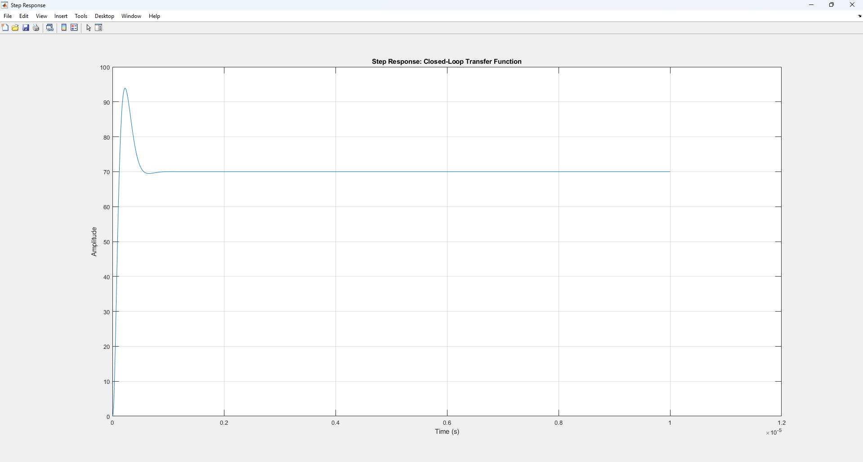
Closed Loop Transfer Function
Notes:
- Description:
The Closed Loop Transfer Function graph represents the behavior of the system when feedback is applied to the loop. It shows the ratio of the output signal to the input signal in the frequency domain after the feedback loop is closed. The graph helps in analyzing the system’s ability to track the input signal while rejecting disturbances, such as noise or unwanted signals.
- Key Insights:
- **Gain and Phase Response**: The closed-loop gain and phase characteristics are essential for understanding how the system behaves in the presence of feedback. It shows the system’s ability to amplify or attenuate signals at various frequencies.
- **Stability and Damping**: The graph reveals how stable the system is after feedback is applied. A stable system will have a flat gain response, while an unstable system will show oscillations or large deviations in the gain.
- **Bandwidth**: The frequency range over which the system can maintain consistent performance without significant attenuation. This is crucial for understanding the system's operational limits.
- **Resonant Frequencies**: Any peaks in the phase response indicate resonance, which can lead to instability if not properly controlled.
- **Phase Margin**: The phase margin is shown as the phase at which the open-loop gain crosses unity (0 dB). This is a measure of system stability.

Slide 10
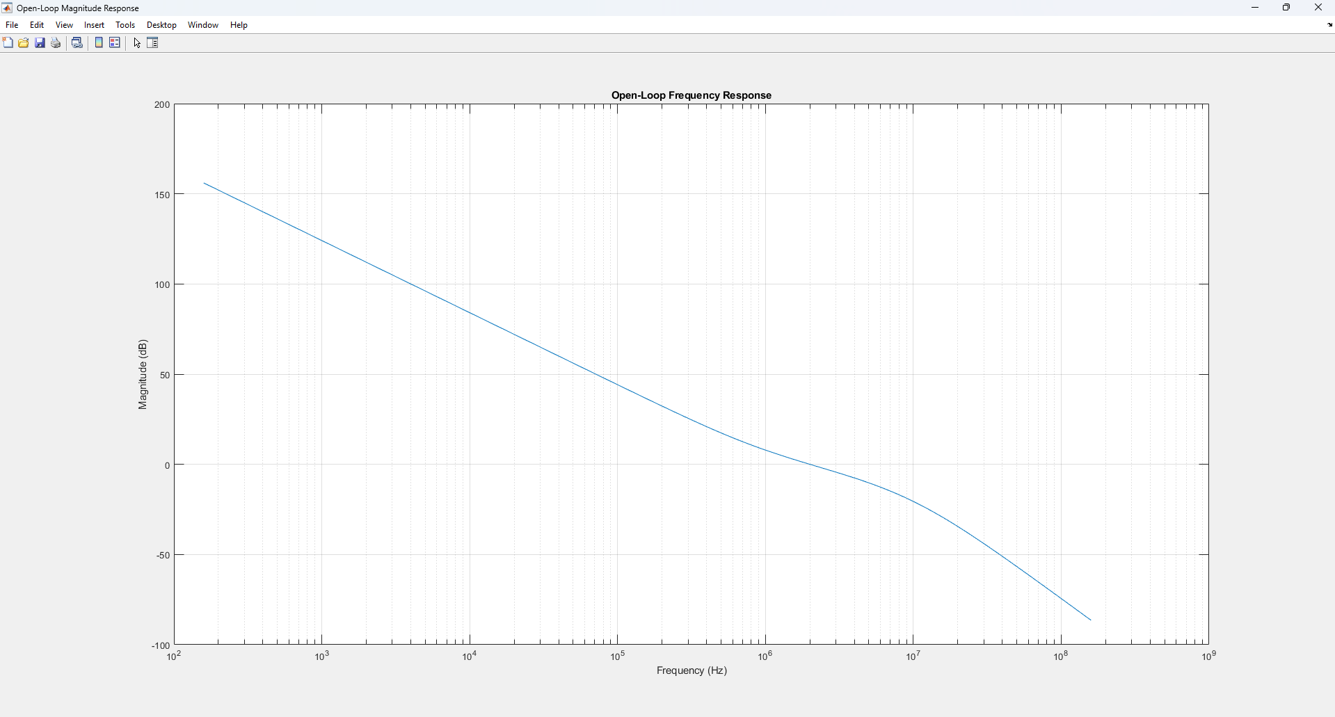
Open Loop Frequency Response
Notes:
- Description:
The Open Loop Frequency Response graph shows how the system responds across different frequencies without feedback. It is the unmodified transfer function of the system and is crucial for evaluating the system’s inherent characteristics before feedback is applied. The graph shows how the system amplifies or attenuates signals at each frequency, providing insights into the system's frequency range and stability.
- Key Insights:
- **Gain vs. Frequency**: The graph reveals how the system amplifies or attenuates signals over a range of frequencies. A high gain in certain frequency ranges can indicate that the system is sensitive to those frequencies, which may be useful or problematic depending on the application.
- **Phase Shift**: The phase response shows how much the system shifts the phase of the input signal as it passes through the system. Significant phase shifts can lead to signal distortion.
- **Bandwidth and Cutoff Frequency**: The bandwidth is determined by the frequency range where the system can operate effectively. The cutoff frequency marks the point where the system's gain drops significantly, which defines the limits of the system’s operating range.
- **Stability Analysis**: The open-loop frequency response is crucial for assessing stability before feedback is applied. Systems with large phase shifts or reduced gain at higher frequencies may be unstable or prone to oscillations when feedback is added.
- **Resonance Peaks**: Peaks in the frequency response may indicate resonance at certain frequencies, which could lead to unwanted oscillations and instability.

Slide 11
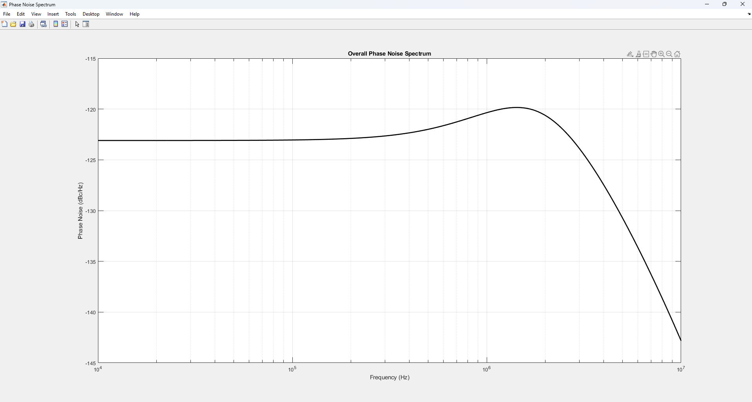
Overall Phase Noise Spectrum
Notes:
- Description:
The Overall Phase Noise Spectrum graph visualizes the phase noise behavior of the system, showing how much noise is present at different frequencies around the carrier signal. Phase noise refers to the rapid, short-term fluctuations in the phase of the signal, and this graph is essential for evaluating the quality of the signal in communication systems. A lower phase noise means a cleaner signal, which is crucial for high-performance applications like radar, communications, and precision measurement systems.
- Key Insights:
- **Phase Noise Power**: The graph plots phase noise power as a function of frequency offset from the carrier signal. The power levels indicate how much noise is present at different frequency offsets.
- **Sideband Noise**: The noise floor surrounding the carrier is often referred to as sideband noise. A lower sideband noise indicates better signal purity, as the noise is less likely to interfere with adjacent channels or signal processing systems.
- **Frequency Offsets**: The spectrum shows how phase noise varies at different frequency offsets from the carrier. Typically, phase noise increases at higher offsets, and understanding this can help in optimizing filter and PLL designs to reduce phase noise.
- **Impact on System Performance**: High phase noise can degrade the system’s signal-to-noise ratio (SNR), leading to errors in data transmission or measurement. This is particularly important in systems requiring high-frequency stability, such as in communications, GPS, or RF systems.
- **Noise Suppression Techniques**: The graph is also useful for evaluating the effectiveness of phase noise suppression techniques, such as the design of low-noise oscillators, PLLs, and filtering.
- **Measurement of Jitter**: Phase noise is closely related to jitter, which can cause timing errors in digital systems. The graph can be used to estimate jitter performance in systems like clock generation or synchronization.

Slide 12
Future Work:
Hardware Integration of the PLL System: Future work could focus on integrating the PLL system into hardware, enabling real-time testing and performance evaluation in practical communication systems.
Machine Learning for Optimizing Phase Noise Performance: The application of machine learning algorithms could be explored to automatically optimize PLL parameters, enhancing phase noise performance and adapting to varying signal conditions.
Notes:
Hardware Integration of the PLL System:
- Description:
Integrating the Phase-Locked Loop (PLL) system into hardware allows real-time testing and performance evaluation in practical communication systems. While the system is currently simulated in software, hardware integration offers several advantages:
- **Real-World Testing**: Allows the PLL to be tested under real-world conditions, including environmental factors such as temperature variations, power supply fluctuations, and component tolerances.
- **Improved Performance Metrics**: By implementing the PLL in hardware, performance metrics such as **signal stability**, **phase noise suppression**, and **frequency accuracy** can be evaluated more accurately.
- **System Integration**: The PLL can be integrated with other hardware components, such as **signal generators**, **modulators**, and **receivers**, enabling end-to-end testing in communication systems.
- **Optimization of Hardware Components**: Hardware integration provides insights into the limitations of real components (e.g., oscillator precision) and offers the opportunity to optimize them for better phase noise performance and signal quality.
- **Evaluation of Power Consumption**: Hardware testing can assess the PLL’s power consumption, a crucial factor in energy-efficient communication systems, particularly for mobile or satellite communications.
Future work could involve **prototyping the PLL on FPGA (Field-Programmable Gate Array)** or **ASIC (Application-Specific Integrated Circuit)**, which are commonly used for high-performance and custom communication systems. This would enable direct hardware-based performance evaluation and optimization.
Machine Learning for Optimizing Phase Noise Performance: - Description:
The application of **machine learning (ML) algorithms** offers an innovative way to optimize the Phase-Locked Loop (PLL) system’s performance, particularly in the reduction of **phase noise**. ML can be used to automatically fine-tune PLL parameters based on varying signal conditions, providing several advantages over traditional design methods:
- **Automated Optimization**: Machine learning models can continuously adjust PLL parameters such as **loop filter coefficients**, **VCO sensitivity**, and **frequency divider ratios** to optimize phase noise performance under different conditions. This reduces the need for manual tuning and speeds up the system's optimization process.
- **Adaptation to Varying Conditions**: ML can help the PLL adapt to changes in the input signal or environmental factors, such as temperature, power supply fluctuations, and aging of components, which can affect the PLL’s performance.
- **Predictive Maintenance**: ML algorithms can predict system behaviors based on historical data, identifying when the PLL might need recalibration or adjustment to maintain optimal phase noise performance.
- **Advanced Noise Modeling**: Machine learning techniques can be used to model complex noise sources and their interactions, enabling more precise noise reduction strategies tailored to specific communication environments.
- **Data-Driven Insights**: By training on large datasets, ML models can uncover patterns and correlations in the PLL system’s performance that might not be immediately apparent through traditional analysis, leading to new ways of improving system performance.
Future work could involve using techniques such as **reinforcement learning** or **neural networks** to create adaptive PLL systems capable of learning from their environment and optimizing parameters in real-time.

Slide 13
CONCLUSION
Project Repository
"For complete project details, code, and documentation,
visit the repository on GitHub:
GitHub Repository Link : Click here
Modular Scripts for Flexibility
Improved Phase Noise Performance
Clear Visualization of System Behavior
Practical Insights for Optimization
Notes:
Modular Scripts for Flexibility: The use of modular scripting enabled flexible and efficient simulation workflows, allowing for easy adjustments and scalability in the simulation process.
Improved Phase Noise Performance: The implementation of PLL simulations resulted in significant improvements in phase noise reduction, enhancing signal stability and quality.
Clear Visualization of System Behavior: The simulations provided clear visualizations of the antenna system's performance, showcasing key metrics such as phase noise levels, system stability, and the effectiveness of various noise reduction techniques.
Practical Insights for Optimization: The results offer valuable insights into optimizing antenna system design for real-world applications, emphasizing the importance of signal integrity and noise management in communication systems.

Slide 14
References Peer-Reviewed Articles on RF and Microwave Technologies
J. Lota and A. Demosthenous, "Low Power Analog Processing for Ultra-High-Speed Receivers With RF Correlation," IEEE Access, vol. 11, pp. 37944-37957, 2023. [Online]. Available: https://doi.org/10.1109/ACCESS.2023.3253042.
M. Lübke, Y. Su, and N. Franchi, "Evaluating RF Hardware Characteristics for Automotive JCRS Systems Based on PMCW-CDMA at 77GHz," IEEE Access, vol. 11, pp. 28565-28584, 2023. [Online]. Available: https://doi.org/10.1109/ACCESS.2023.3259725.
K. Kossenas, S. K. Podilchak, and M. Beveridge, "Microwave System Development for Wireless Communications Inside Oil and Gas Well Pipelines," IEEE Journal of Microwaves, vol. 3, no. 2, pp. 553-569, 2023. [Online]. Available: https://doi.org/10.1109/JMW.2022.3232032.

Slide 15
References Software References for Antenna Modeling and Simulation
A. Dyana, "System-Level Radar Simulation Using Model-Based Design," MATLAB EXPO, Hyderabad, India, 2018. [Online]. Available: https://www.matlabexpo.com.
MathWorks, "Antenna Modeling and Analysis - MATLAB & Simulink." [Online]. Available: https://www.mathworks.com.
"Simulation of MIMO Antenna Systems in Simulink," MATLAB and Simulink, MathWorks. [Online]. Available: https://www.mathworks.com.

Slide 16
THANK YOU

